Slide 1






Art Gallery
Project Guide:Prof.Mrs.Kiran Tiwari
Presentation By:
Arpita Jadhav
Gayatri Phapale
Maithili Shelke
Anjali Singh

Slide 2
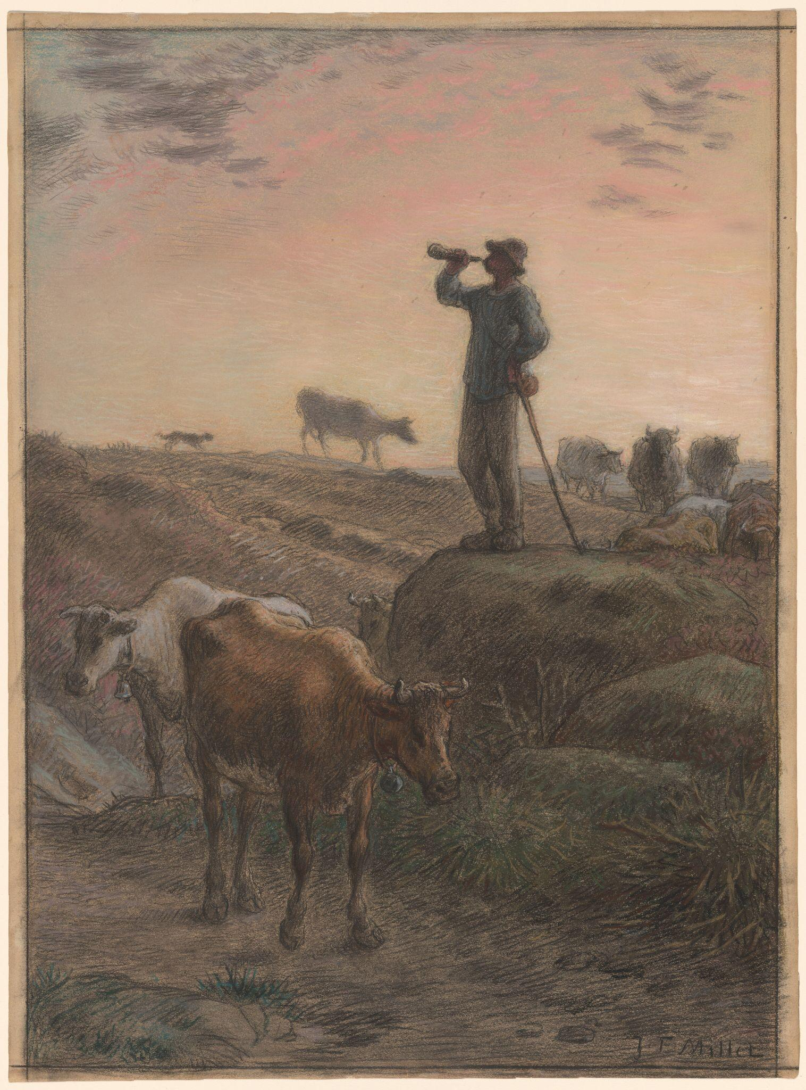
Overview
Aim
Entities
ER-Diagram
Technology Stack
Project Features
Back-End Architecture
Front-End Architecture
Demo Screenshots
Future Upgradation
Conclusion
Jean-François Millet Calling Home the Cows, c. 1866

Slide 3
Aim of Project
The aim of the art gallery website is to create a dynamic online platform that showcases various forms of artwork, promotes artists, and enhances user experience.
Through intuitive design and functionality, the website aims to facilitate art sales, educate visitors about different art styles and movements, foster community engagement, and support art events. Ultimately, the goal is to create a vibrant online hub for art enthusiasts and artists to connect, explore, and appreciate the world of art.

Slide 4
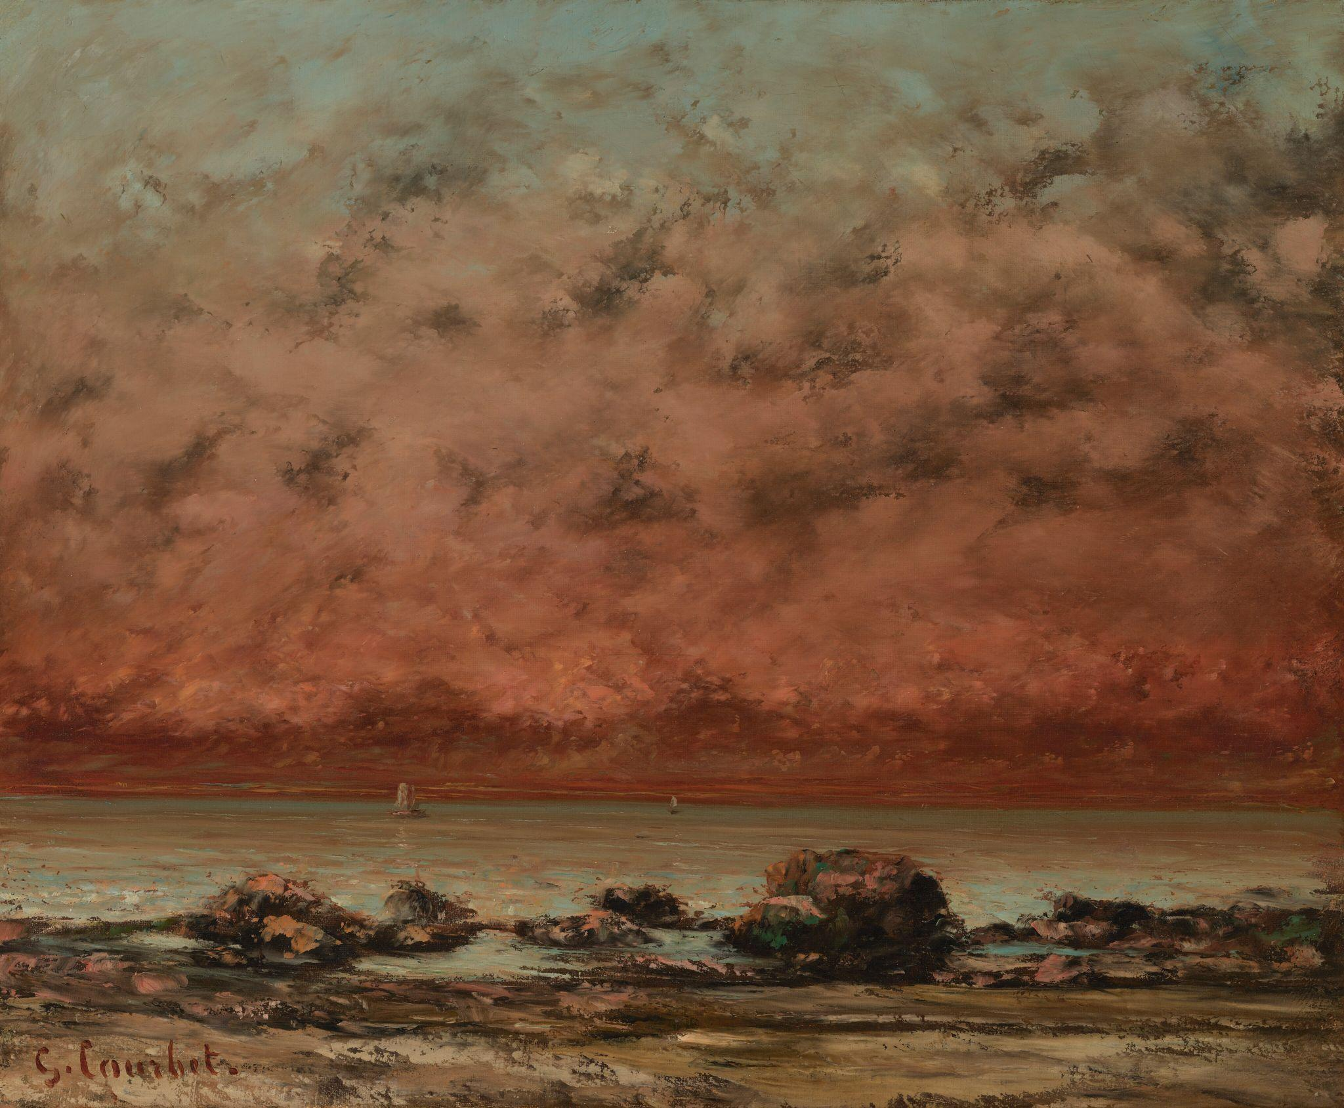
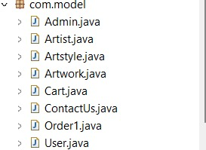
Entities

Slide 5
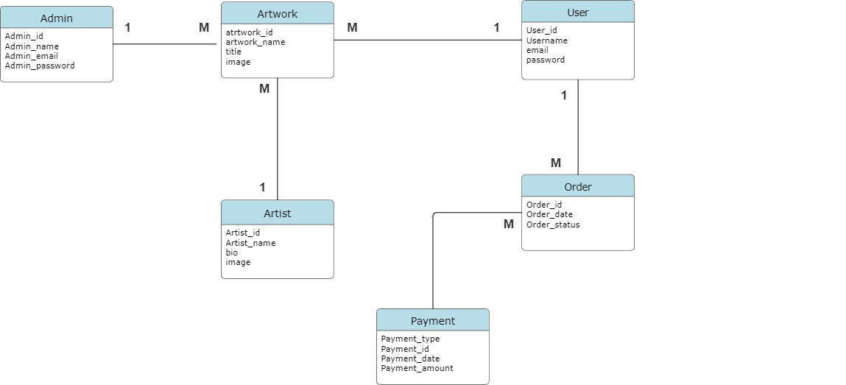
ER-DIAGRAM

Slide 6
Technology Stack
HTML-
HTML(Hyper Text Markup Language) is the code that is used to structure a web page and its content.
CSS-
CSS(Cascading Style Sheets) is used to style and layout web-pages for example, to alter the font , color, size and other decorative features.
ANGULAR-
Angular is a platform and framework for building single page client applications using HTML and Typescript Angular is written Typescript.
SPRINGBOOT & MYSQL-
Spring boot and MySQL are commonly used together in building strong and scalable web applications

Slide 7
Project Features
Diverse Art Collection:
Our gallery showcases a wide variety of artworks, including paintings, sculptures, and digital art from both emerging and established artists.
Online Viewing:
Visitors can browse the gallery's collection online, view high-resolution images of the artwork, and read about the artists and their inspiration.
Artist Profiles:
Detailed profiles of each artist are available, providing background information, artist statements, and a portfolio of their work.
Art Store:
We have an art store where visitors can purchase prints, posters, art books, and other art-related merchandise.

Slide 8
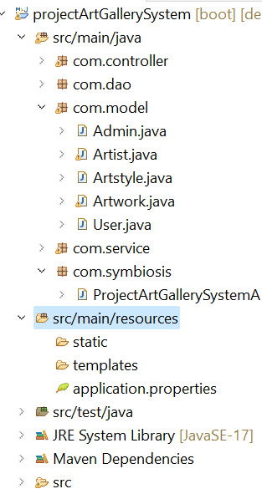
BACKEND ARCHITECTURE
1.Encapsulation:
Wrapping up of data member
and member functions in single
unit.
2. Abstraction:
Hidding implementation and
showing functionality

Slide 9
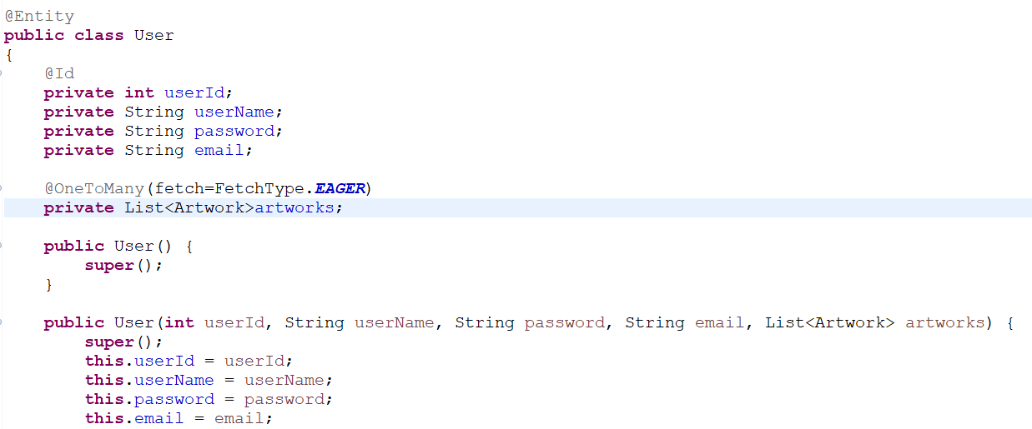
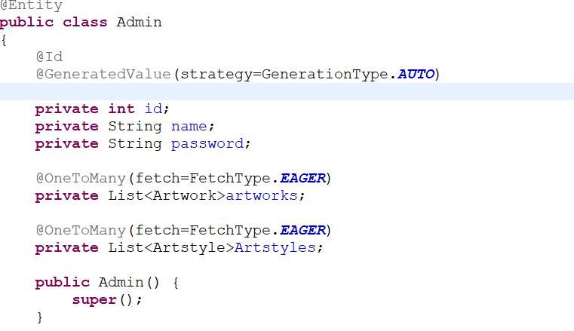
BACKEND ARCHITECTURE
JPA MAPPING

Slide 10
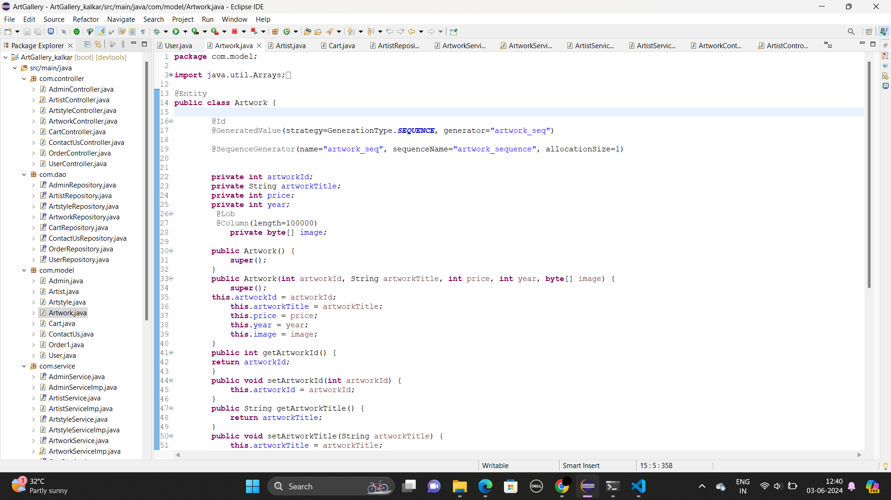
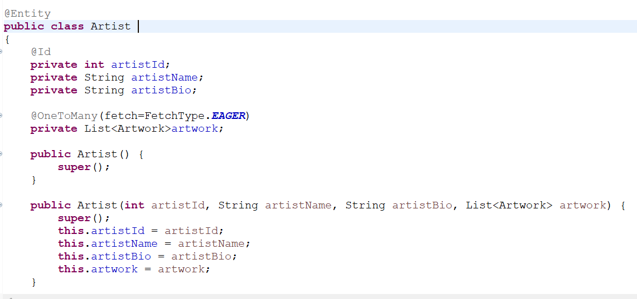
BACKEND ARCHITECTURE
JPA MAPPING

Slide 11
BACKEND ARCHITECTURE
JPA MAPPING

Slide 12
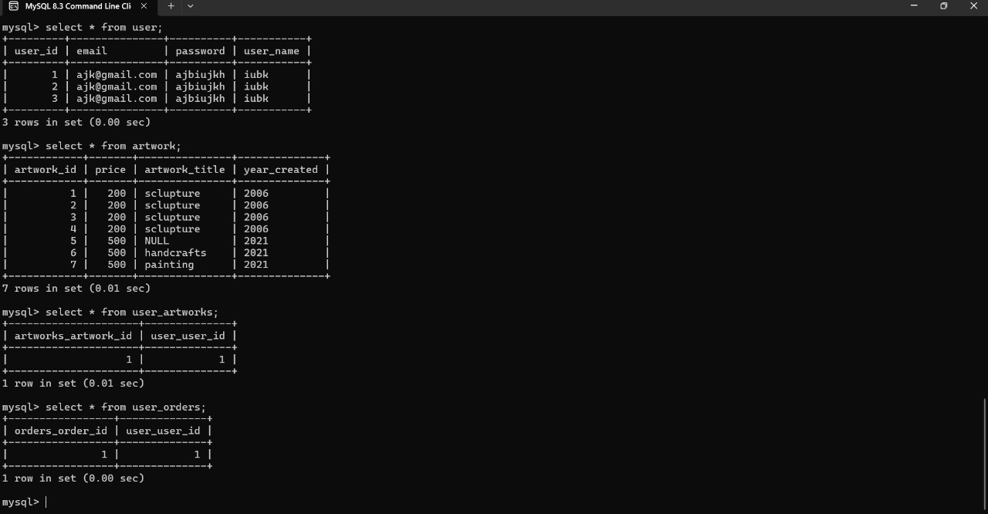
BACKEND ARCHITECTURE

Slide 13
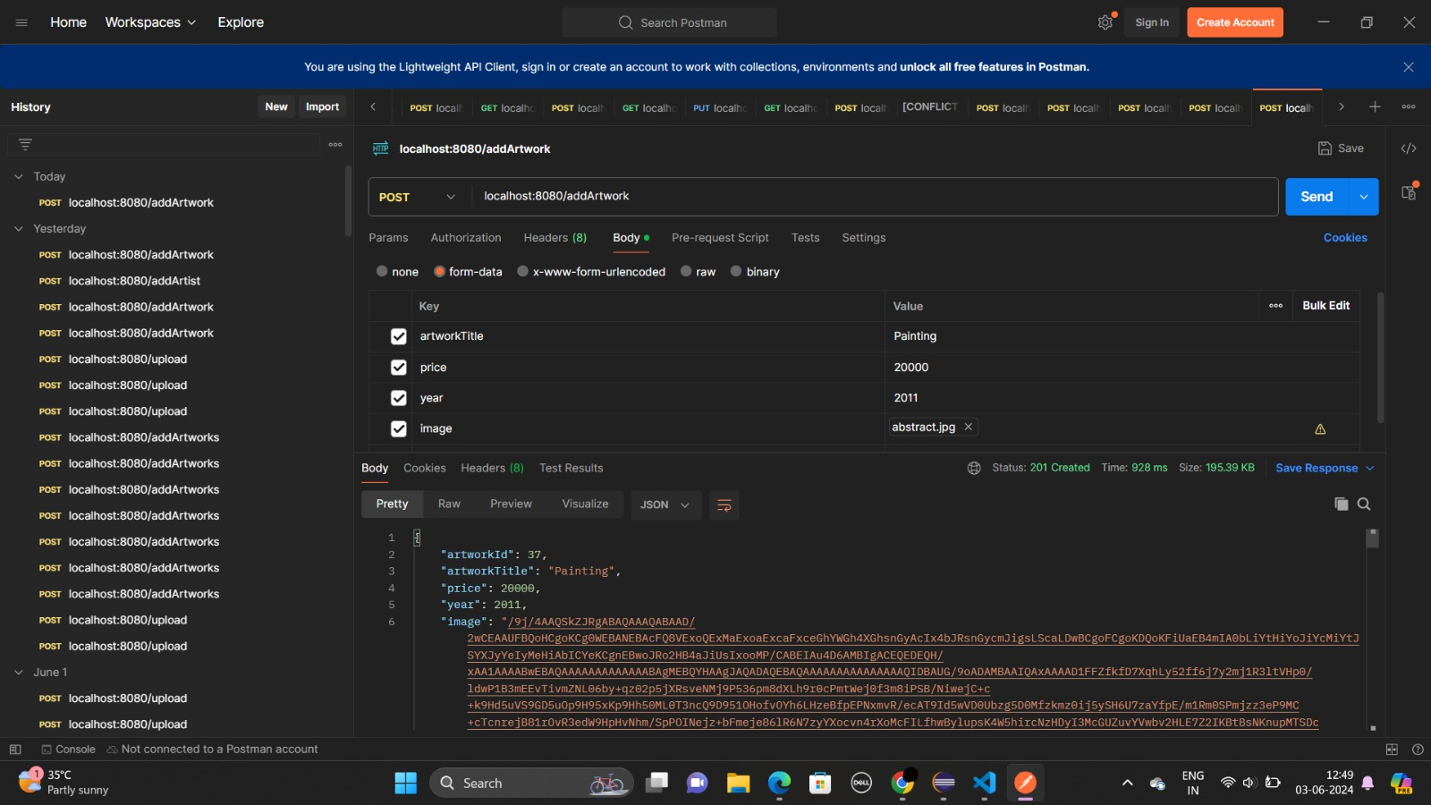
BACKEND ARCHITECTURE
Postman:
Postman is an application used for API testing.
METHODS:
GET
POST
PUT
DELETE

Slide 14
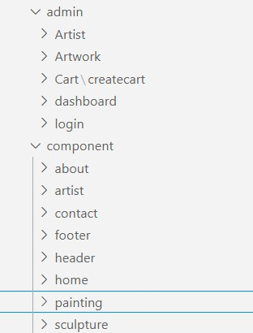
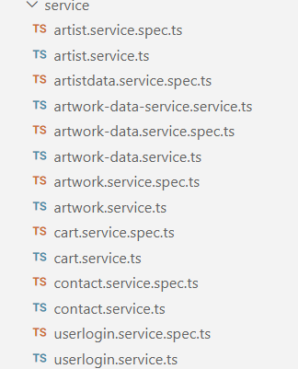
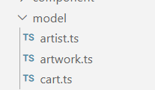
FRONTEND ARCHITECTURE
Components
Services
MODELS

Slide 15
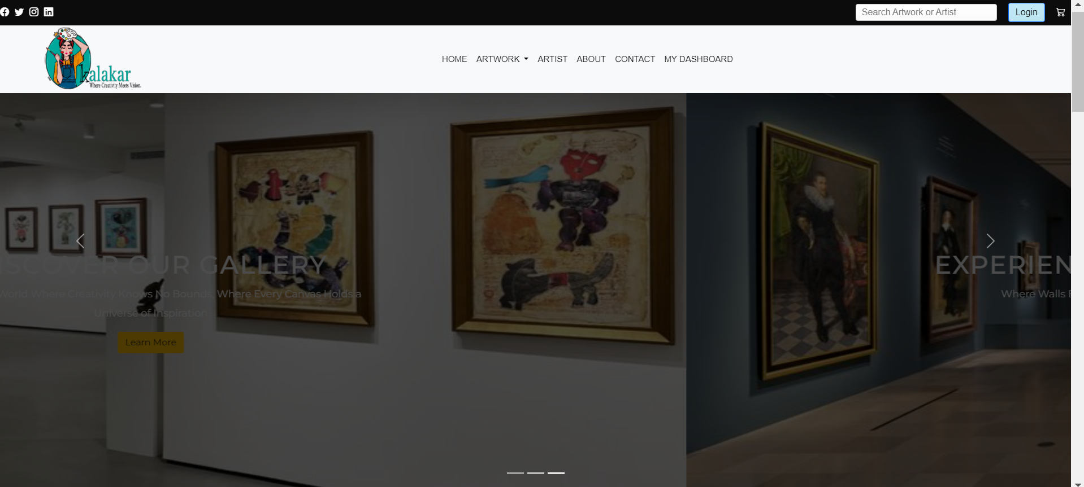
Demo Screenshot

Slide 16
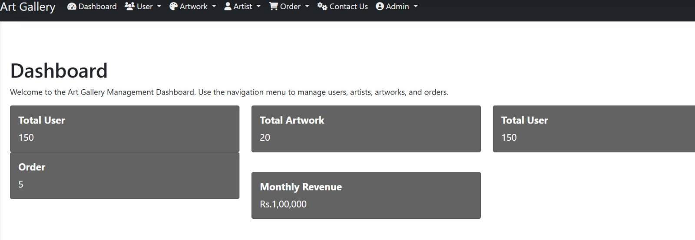
Demo Screenshot

Slide 17
Conclusion
In conclusion, our art gallery website project combines the elegance of Angular frontend with the robustness of Java Spring Boot backend to create a comprehensive platform for artists, art enthusiasts, and administrators alike. The backend architecture, driven by Spring Boot, ensures efficient data management, authentication, and security measures, guaranteeing a smooth and secure experience for all users.

Slide 18
Thank You !

